Slide 1



Innovation Laboratory
AE39201
ATTENUE
SMART ATTENDENCE SYSTEM
Final Presentation

Slide 2
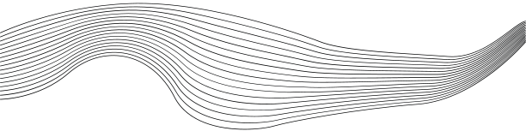
CONTENT
01
INTRODUCTION
02
PROBLEM
03
SOLUTION
04
STEPS
05
PROGRESS
06
IOT
07
PTODUCT

Slide 3

INTRODUCTION
The Smart Attendance System using Computer Vision is an automated solution designed to streamline the process of marking attendance in classrooms. By leveraging face recognition technology, the system enables professors to capture a photo of the class, which is then processed to identify students and automatically record their attendance. This eliminates the need for manual roll calls, saves time, and enhances accuracy, providing a modern, tech-driven approach to classroom management.

Slide 4
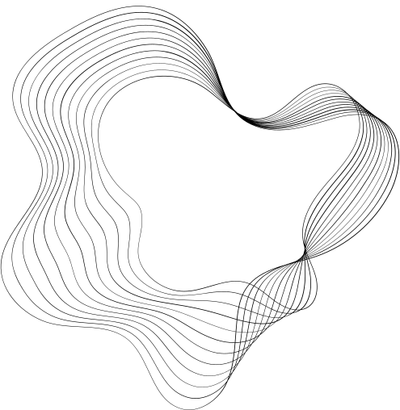

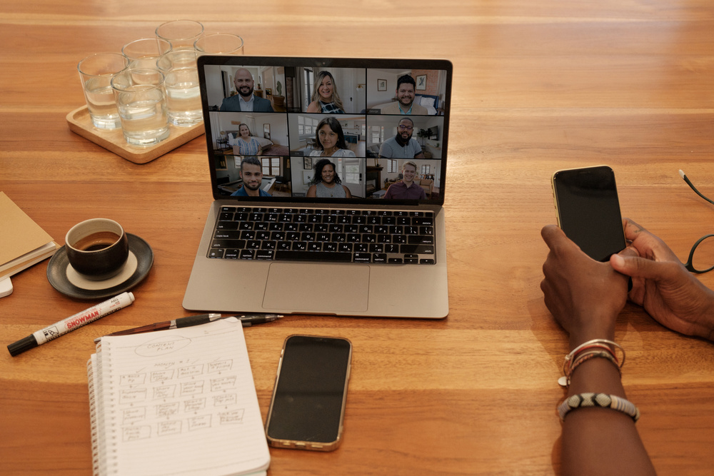
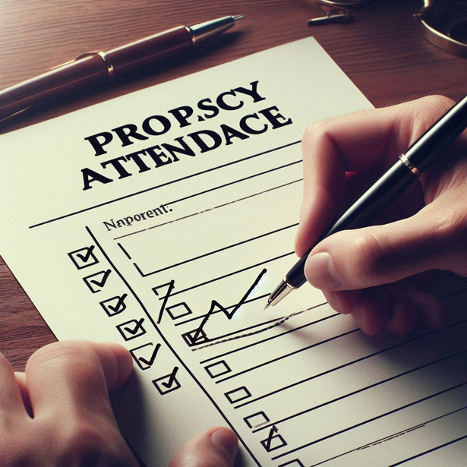

PROBLEMS
Manual Attendance is Time-Consuming and Prone to Errors:
In large classrooms, taking attendance manually consumes valuable lecture time and often results in errors, such as missed entries or incorrect marking.
Lack of a Reliable System to Prevent Proxy Attendance:
Traditional attendance methods allow for the possibility of proxy attendance, where students can mark attendance for absent peers, leading to inaccurate records.

Slide 5
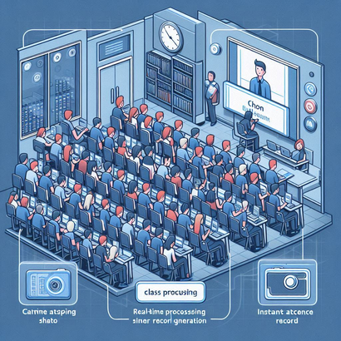

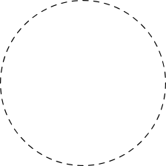
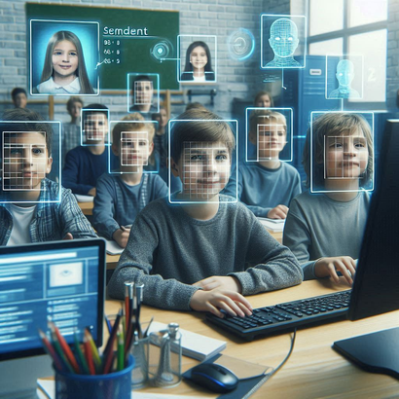
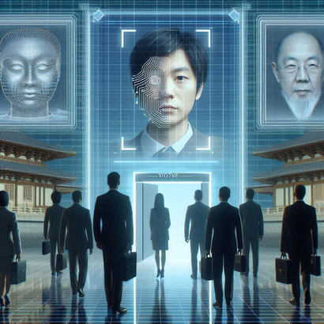


SOLUTIONS
Real-Time Processing and Instant Record Generation: The system processes the class photo in real-time, generating attendance records almost instantly, preventing delays and minimizing disruption during lectures.
Automated Attendance through Face Recognition: By using computer vision to automatically identify and record the attendance of students from a classroom photo, the system reduces the time spent on manual attendance.
Elimination of Proxy Attendance: With facial recognition technology, each student is uniquely identified based on their facial features, ensuring that only present students are marked, thereby preventing proxy attendance.

Slide 6

STEPS
01
02
03
04
MAKING OF COMPUTER VISION MODEL
MAKING
OF APPLICATION
INTEGRATE THE MODEL WITH THE APPLICATION
IOT

Slide 7

PROGRESS
Now we are importing data (images) directly from Google-Drive
IOT Model is ready, now we are able to capture image and process it from Raspberry Pi itself. And export to model directly
initially we were embedding images every time, but now we embed it only once and use the same for the number of time

Slide 8
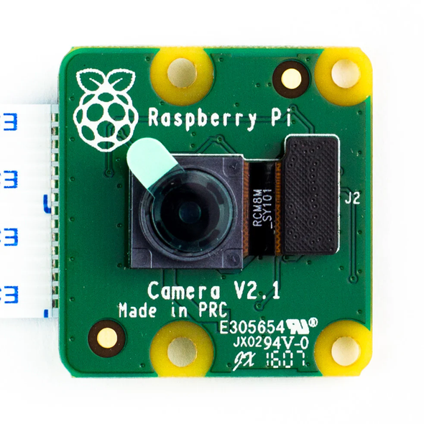
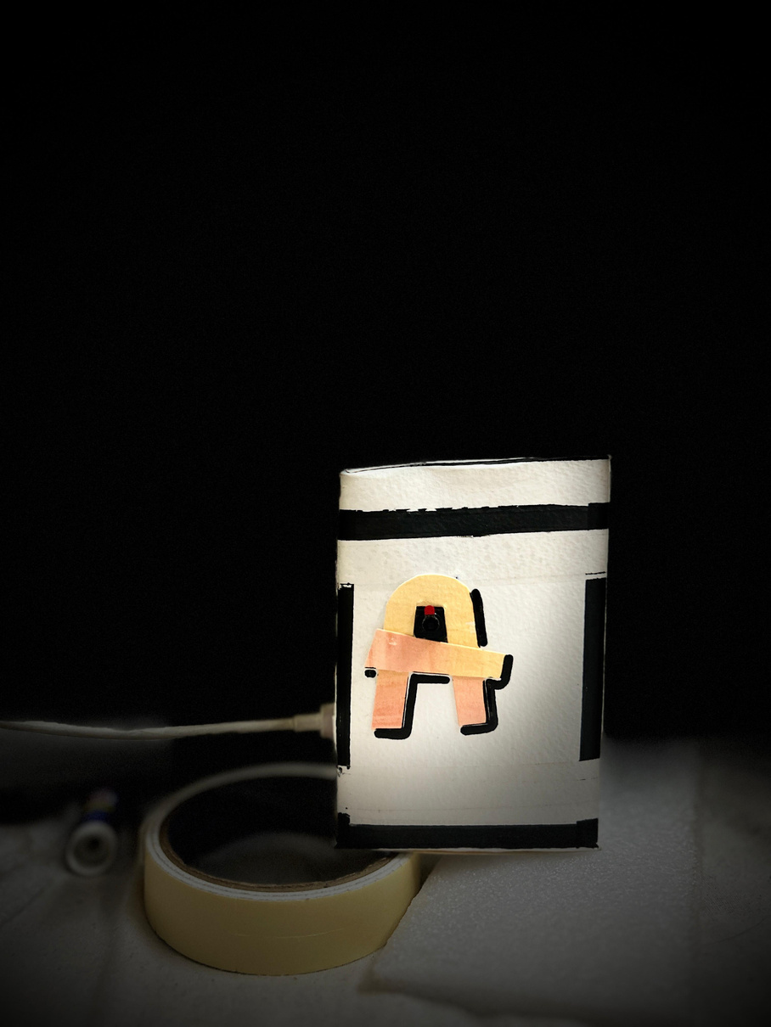
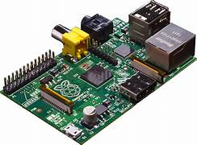


IOT
Raspberry Pi
Camera Module
Attenue

Slide 9
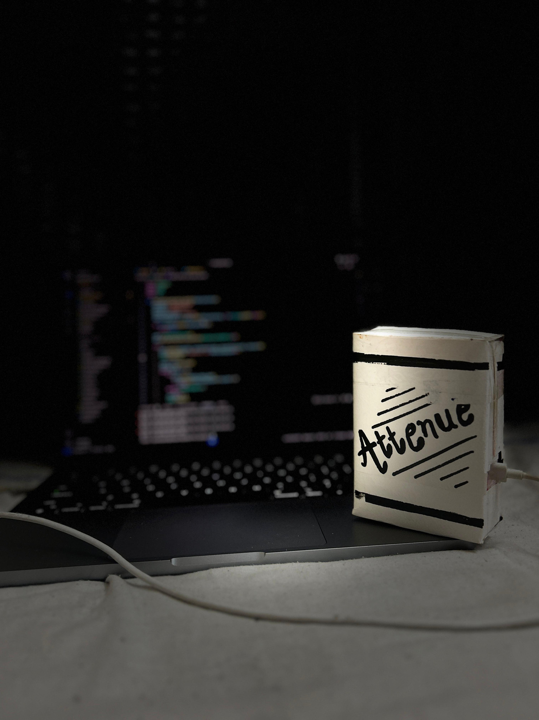
REVENUE MODEL
Document Link:
https://docs.google.com/document/d/1dpl5iwYFx7Eijk9IDqHALnqHFLW2p4f4/edit?usp=sharing&ouid=117029742341889742871&rtpof=true&sd=true

Slide 10
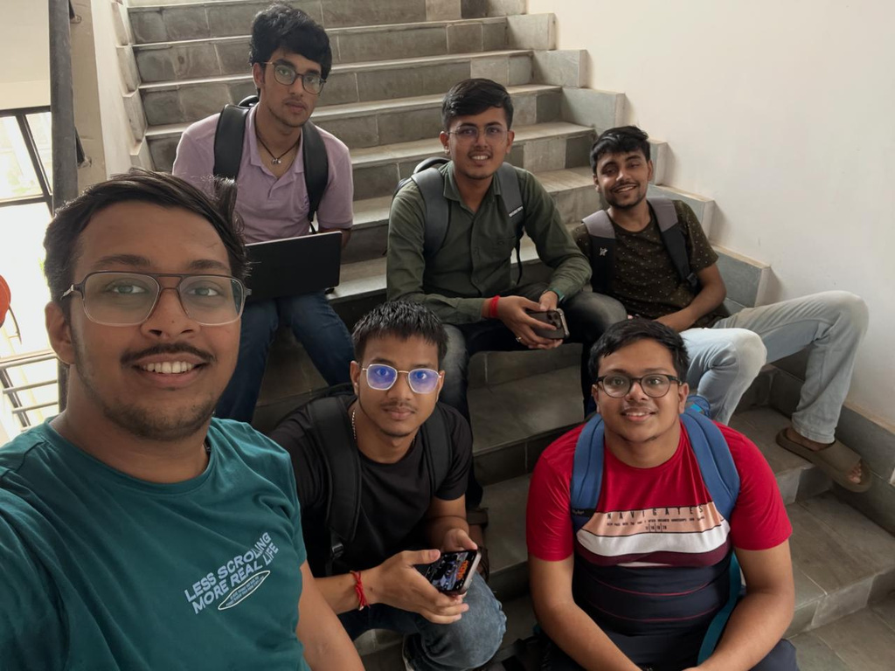
OUR TEAM

Slide 11

THANK YOU
Team ATTENUE

